Slide 1



Statistical Analysis and Learning (SAL) Textbook: An Introduction to Statistical Learning (ISL)
Varun Rai (Ph.D., Stanford)
LBJ School of Public Affairs
The University of Texas at Austin
17th January 2018

Slide 2
Note on Material
Unless otherwise noted, all material in this presentation are from this course’s textbook, An Introduction to Statistical Learning (ISL)

Slide 3
Data Science/Advanced Analytics/Learning
Data science: A set of fundamental principles that enable the extraction of knowledge from data.
Extraction of what kind of knowledge?
Identification of hidden (i.e., non-obvious) patterns in the data: “Insights for innovation”
Identification of areas to improve, especially in high-volume, repeat business operations: “Increase operational efficiency”
Extract how?...

Slide 4
What is Statistical Learning?
Statistical learning refers to a vast set of tools for understanding data. These tools can be classified as supervised or unsupervised.
Supervised statistical learning involves building a statistical model for predicting, or estimating, an output based on one or more inputs. Problems of this nature occur in fields as diverse as business, medicine, astrophysics, and public policy.
With unsupervised statistical learning, there are inputs but no supervising output; nevertheless we can learn relationships and structure from such data.

Slide 5
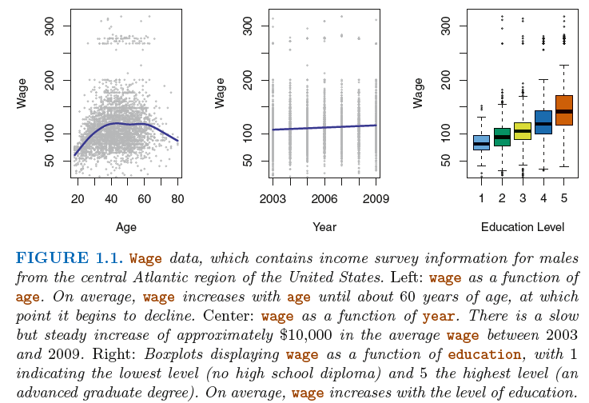
Wage Data Example: Quantitative Outcome

Slide 6
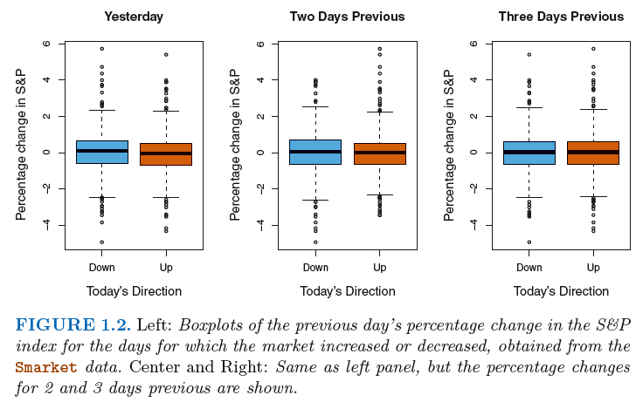
Stock Market Example: Qualitative Outcome
Notes:
Classification problem.

Slide 7
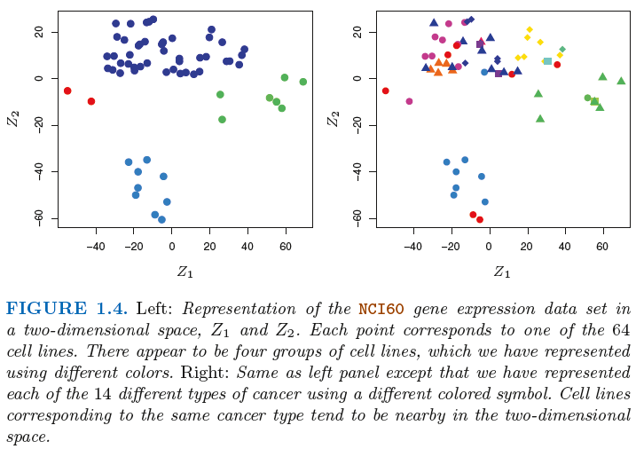
Gene Expression Example: Clustering/High-D
Notes:
The left-hand panel of Figure 1.4 addresses this problem by representing
each of the 64 cell lines using just two numbers, Z1 and Z2 . These
are the first two principal components of the data, which summarize the
6,830 expression measurements for each cell line down to two numbers or
dimensions .

Slide 8
Another Clustering Example
Countries by their 1976 crude birth and death rates per 100,000 people
Source: JMP

Slide 9
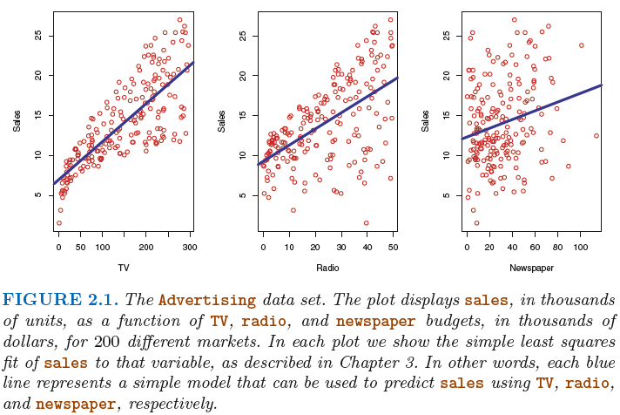
Predictor and Outcome Variables
Two main types of variables:
Input/Predictor/Independent/features: X = (X₁, X₂,..., X_{p})
Output/outcome/dependent/response: Y

Slide 10
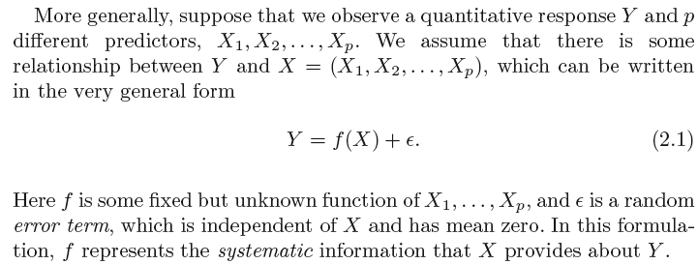
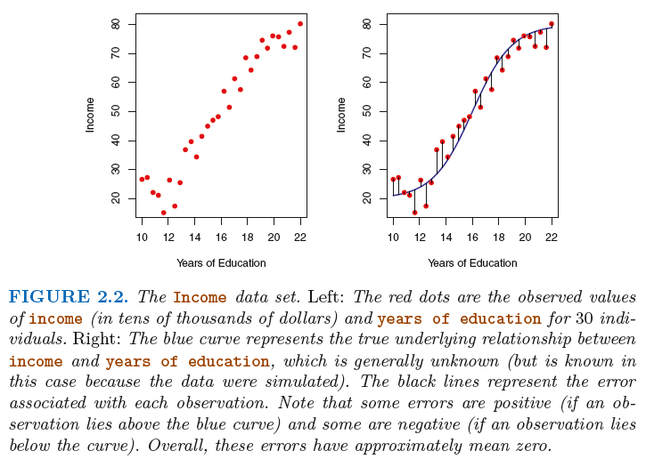
Quantitative Response Y and its p predictors

Slide 11
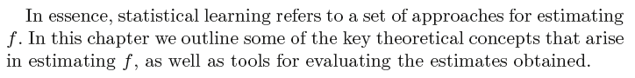
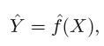
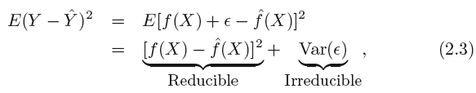
Statistical Learning

Slide 12
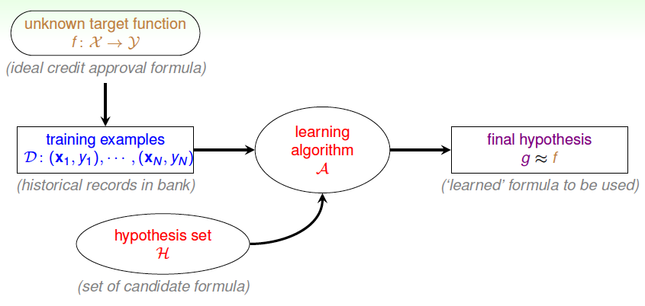
The Process of Learning
Source: Learning From Data, 2012.

Slide 13
Why Study Statistical Learning?
Inference: direction and/or magnitude of predictors influence on the outcome variable is of interest
Does human activity cause climate change?
Will administering drug X increase chances of survival in a patient?
Other examples?
Prediction: only the value of the outcome variable is of interest
How much rainfall will California have in 2050?
How much solar photovoltaic (PV) will be installed in the U.S. in 2025?
Other examples?
Some times both are of interest, but often only one (inference or prediction) is of primary interest
The primary objective of the analyst has a huge bearing on the selection of methods for statistical learning.

Slide 14
What’s the Best Statistical Learning Method?
None! (...for all types of datasets)

Slide 15
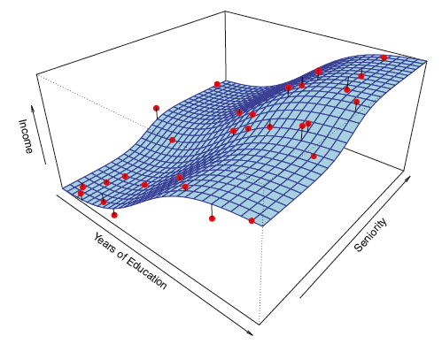
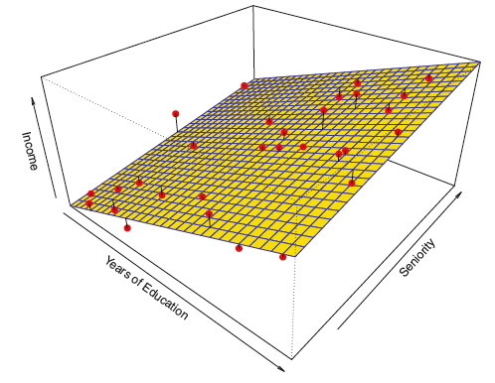
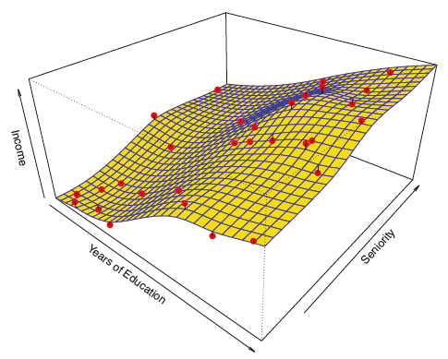
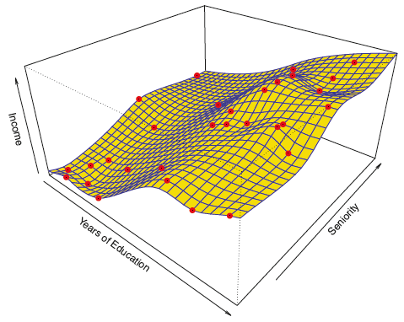
Statistical Learning
Notes:
thin-plate spline

Slide 16
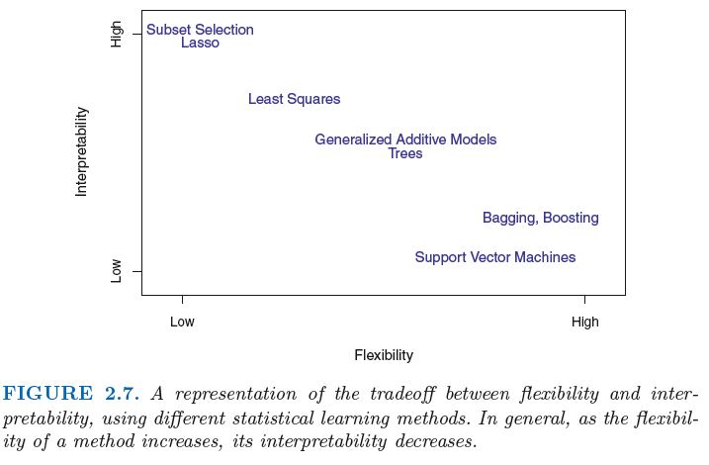
Statistical Learning

Slide 17
Some Important Aspects of Statistical Learning: Recurring Themes in the Course
Interpretation vs. Flexibility (predictive accuracy, often)
Model selection: choosing the best model for a problem/data
Overfitting
Training vs. test errors
Bias-Variance tradeoff

Slide 18
Operating Principles of this Course
Focus on most widely applicable methods; not everything.
Look inside the “black box” of methods; understand how things work and interact.
Not mathematically heavy: need only to know how the blackbox works, no how to create it!
Focus more on applications and hands-on experience.

Slide 19
What You Will Learn in This Course...
Regression Basics++
Classification
Parametric and non-parametric methods
Supervised and unsupervised methods
Inference vs. prediction

Slide 20
Skills Developed by the End of This Course...
Statistical concepts: revisited, refreshed, high-freq. use
Statistical learning methods
Model selection
Hand-on data analysis experience in R/Python
Overall, a general, systematic approach to statistical learning that you can (and should) apply to any new relevant problem.

Slide 21
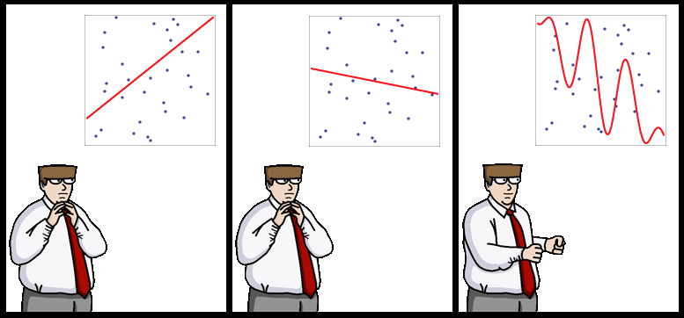
Welcome to SAL!
Source: http://yaroslavvb.blogspot.com/

